Slide 1



Jobs

Slide 2


Let’s talk about jobs

Slide 3


Let’s answer the questions
What do you do?
What does your family member do?
What job do you think is very important in our society? Why?

Slide 4


1. What do you do?

Slide 5





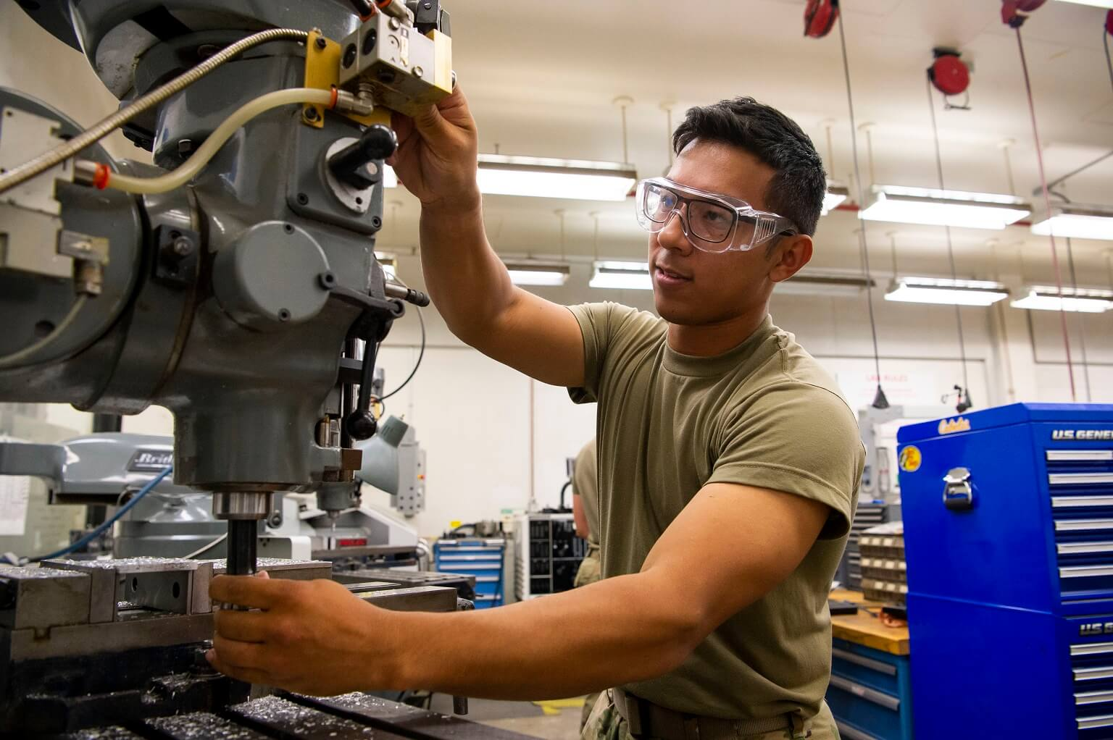

Student (n)
/ˈstjuːdənt/
Doctor (n)
/ˈdɒktə/
Teacher (n)
/ˈtiːʧə/
Worker (n)
/ ˈwɜːkə/
Farmer (n)
/ ˈfɑːmə/
Engineer (n)
/ ˌɛnʤɪˈnɪə/

Slide 6
Q: What do you do?
→ I am a/an ___.
Example:
- I am a student.
- I am an engineer.

Slide 7




2. What does your family member do?

Slide 8
Q: What does your family member do?
→ My _______ is a/an _______.
Example:
- My mother is a teacher.
- My father is a doctor.

Slide 9
3. What job do you think is very important in our society? Why?
→ I think _______ is very important in our society because _______ .
Example:
- I think doctor is very important in our society because they can help sick people.
- I think engineer is very important in our society because they help produce and design systems.

Slide 10


Now let’s talk about jobs !

